Slide 1
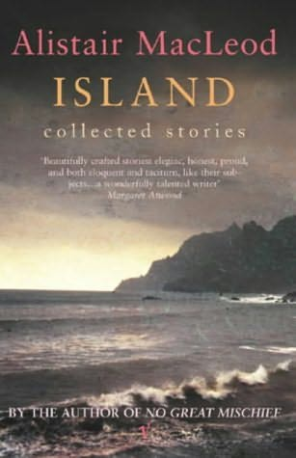
Island – Collected Stories by Alistair MacLeod
Area of study one: reading and creating texts (creative response)

Slide 2
What are the Outcome requirements?
Students present sustained creative responses to selected texts, demonstrating their understanding of the world of the texts and how texts construct meaning. In developing a creative response they explore issues of purpose and audience and make key choices about structure, conventions and language. They develop a credible and effective voice and style and use the chosen features of the selected text, for example characters, narrative or dialogue, to offer an interpretation of the selected text. They produce and share drafts, practising the skills of revision, editing and refining for stylistic and imaginative effect.
In pairs, go through the highlighted key words and phrases and discuss the skills you need to demonstrate to successfully complete this Outcome.
As a class, discuss any questions or comments you may have in regards to this.

Slide 3
How do I write ‘in the world of the text’?
You do not have to write like Alistair MacLeod
To write in ‘the world of the text’, you simply need to consider what type of world the author has created for their reader
It’s more than just the physical setting of the text; other aspects of the text such as character, plot, narration, mood and atmosphere all contribute to the world of the text and hence, how we become involved in and react to it
Each time you love or hate a character or get immersed in the setting or the time of a text, you are reacting to it and engaging with the world of the text. Very simply: how does the text make you feel?

Slide 4
Things you will need to know and understand:
Author background
Historical background/setting
Plot (for selected stories)
Character/s (for selected stories)
Context
Views and Values
Perspectives
Structure
Style
Language and tone
Narrative voice

Slide 5
Let’s start with… What do you already know about ‘Island’?
As a class, brainstorm what you already know from your reading of the text

Slide 6
What comes to mind when you hear the word ‘Island’?
Why do you think ‘Island’ was chosen as the title for the collection of stories? What does this symbolise?

Slide 7
The author and his writing:
Born 1936
Died 2014
Born in Saskatchewan (mainland Canada), but raised mostly on Cape Breton Island, Nova Scotia
Father was a miner and he, too, worked in mines as well as logging and fishing industries
MacLeod often returned to Cape Breton, where he worked on his writing
He only published one novel, the stories in ‘Island’ and one other short story – he was renowned for writing very slowly.
‘he says he worked on his writing sentence by sentence, only moving on when each was complete’
Many of his stories feature protagonists from Cape Breton Island, central characters are particularly concerned with their Highlander cultural heritage and family history.
There is a strong theme of family loyalty and relationships throughout his narratives

Slide 8
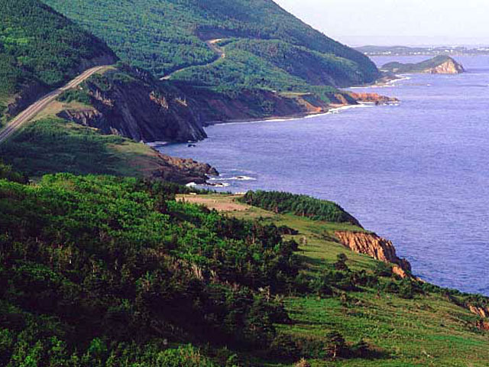
The Geographical Setting
Majority of the stories are set in the Canadian peninsular province of Nova Scotia, mostly the Cape Breton Island region
Cape Breton Island = a slightly larger area size than Melbourne
The peninsula is fairly isolated, connected to the mainland only by a causeway built in the 1950s
Many live in the more remote coastal areas rather than the urbanised inland settings
Newfoundland (‘The Lost Salt Gift of Blood’) – a neighbouring province of Nova Scotia

Slide 9
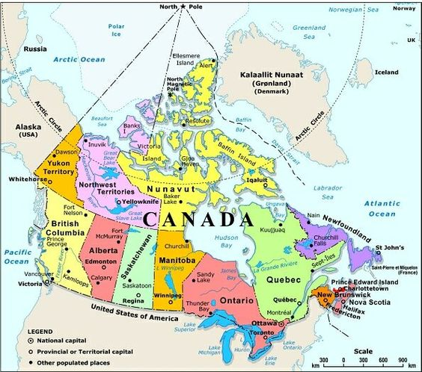
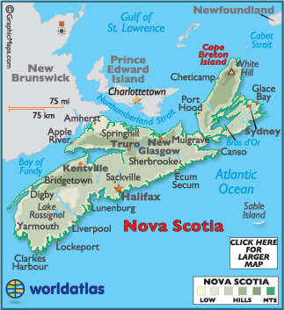

Slide 10
The Historical and Social Setting
Nova Scotia (Latin for ‘new Scotland’)
Much of it’s history and culture are closely tied to marine activities
Declines in fish populations and changes to demand are reducing the province’s dependence on the industry (this decline is reflected in a number of the stories)
Mining is still an important economic factor for the region, but shifts have occurred in the industry. Coal is no longer the primary resource, so main coalmines have closed (again, a recurring issue in ‘Island’)
Tourism is an increasingly important economic contributor (‘The Boat’ and ‘Island’)
The decline in the traditional industries forms a strong backdrop to the collection of stories, with an underlining tone of poverty and economic depression
There is a clear resistance to the idea of ‘outsiders’
In Cape Breton, there is a strong Gaelic culture: a result of early settlement by Scots.
While the official languages of Canada are English and French, the Gaelic language is common among Cape Breton Islanders of Scottish descent
Some of the characters speak Gaelic with friends and family or sing traditional Gaelic songs as a way of connecting with their own past and culture.

Slide 11
To give you an idea… (https://youtu.be/DaD7ZYH6o)

Slide 12
Island – the collection of stories
Sixteen short stories set mostly in Nova Scotia, many on Cape Breton Island
Chronicle the lives of fishermen, miners, farmers and their families
The protagonists of all of the stories (excluding ‘Island’) are male
Mostly first-person narrators
The stories are mostly concerned with moments or periods of transition
Childhood to adulthood (rite-of-passage, shifting interests, leaving home, returning home
Changes to community and a culture with the passing of time
Stories are also interested in exploring experiences of love (family love – particularly father/son or romantic love – lost love)
There is often a focus on independence, responsibility, decision-making and whether to continue a family tradition or to leave their home community to follow other interests
The stories often present a bleak view of the remote fishing and mining communities, yet the narrator generally describes their home with great affection, respect and detail
While the stories are independent of one another, there are many recurrent ideas, images, themes, motifs and concerns

Slide 13
Story Table
TITLE | Main Character & Age | Main Location | Themes & Ideas
‘The Boat’ | Unnamed older man; himself as a boy | Cape Breton | Tradition, education/literature, death
‘The Vastness of the Dark’ | James, 18 | Cape Breton; Nova Scotia | Tradition, transition, outsiders, belonging
‘The Golden Gift of Grey’ | Jesse, 18 | Indiana | Transition, education
‘The Return’ | Alex, 10 | Montreal; Nova Scotia | Tradition, transition, outsiders, belonging
‘The Lost Salt Gift of Blood’ | Unnamed man, 33 | Newfoundland | Transition, outsiders, belonging
‘The Road to Rankins Point’ | Calum, 26 | Cape Breton | Tradition, transition, belonging, death
‘The Closing Down of Summer’ | Unnamed miner, probably in his 50s | Cape Breton | Tradition, transition
‘To Every Thing There is a Season’ | Unnamed boy, 11 | Cape Breton | Transition, death
‘Second Spring’ | Unnamed boy, early teens | Not stated | Tradition, transition
‘Winter Dog’ | Unnamed older man, himself as a boy | Ontario; Cape Breton | Death
‘The Turning of Perfection’ | Archibald, 78 (and as a younger man) | Cape Breton | Tradition
‘Vision’ | Unnamed man; his father, Alex, as a child and young man | Not stated | Tradition, death
‘Island’ | Agnes MacPhedran | Not stated | Tradition, transition, outsiders, belonging, death

Slide 14
Focus Stories
The Boat
The Vastness of the Dark
The Return
The Lost Salt Gift of Blood
The Road to Rankin’s Point
Island

Slide 15
SAC Topics
Choose ONE of the following tasks to demonstrate a creative interpretation of the selected text:
Fill a silence in the text For example: prologue, epilogue, giving a voice to a silent character
OR
Present an alternative perspective from a selected story For example: the father’s perspective in The Return, the grandmother’s perspective in The Road To Rankin’s Point, the grandfather’s or boy’s perspective in The Lost Salt Gift of Blood.

Slide 16
References
Insight Text Guides: Alistair MacLeod’s ‘Island’
VATE Inside Stories, Island: Collected Stories by Alistair MacLeod
Oxford Reading and Creating, Reading and Comparing – Horne, Nolan & Williams

Slide 17
A ‘quick write’…
Look at ‘The Boat’ (page 3) where the narrator describes his earliest memory of his mother.
Note the use of repetition of “the boat”
Select an object that you associate with your childhood and write a short paragraph connecting your earliest memories of your father/mother with the selected object.

Slide 18
Story Summaries
Form small groups and choose one of the selected six focus stories.
Each group will be responsible for developing a short summary for the story
Your summary should include:
- In brief, what the story is about
- Specific language features of the story EG. Imagery, first-person narrative
- Key ideas and/or themes expressed in the story
- How the story made each group member feel
Each group will be required to report their summary to the class with an expectation that they will e-mail a clear and accurate document to the teacher in order to share with the rest of the class.

